Slide 1
Bird species Identification from an image
Manideep Chenna(042)
Jagadeesh reddY(039)
Batch no:122

Slide 2
Table of Contents
Motivation
Problem Statement
System Design
Data Set
Algorithm
Implementation
Results
Conclusion & Future Scope
Bibilography

Slide 3
Motivation
Identification of bird species is a challenging task often resulting in ambiguous labels.
Even professional bird watchers sometimes disagree on the species given an image of a bird.

Slide 4
Problem Statement
The project aims to quantify the qualitative description of different bird species using machine learning techniques and use it as an effective tool for bird species identification from images. This project attempts to design and adopt the bird species identification system based on image feature analysis.

Slide 5
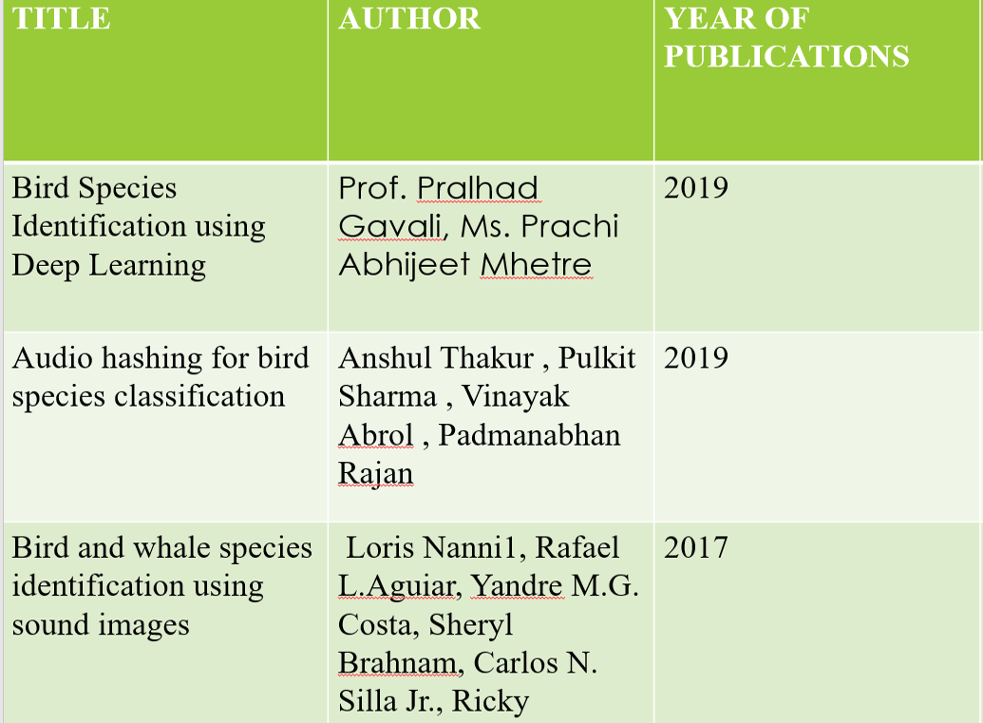
Literature Survey

Slide 6
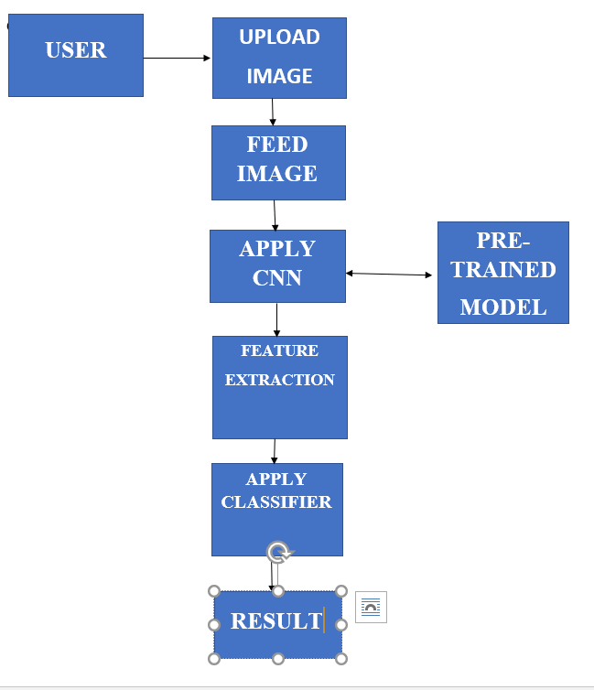
System Design

Slide 7
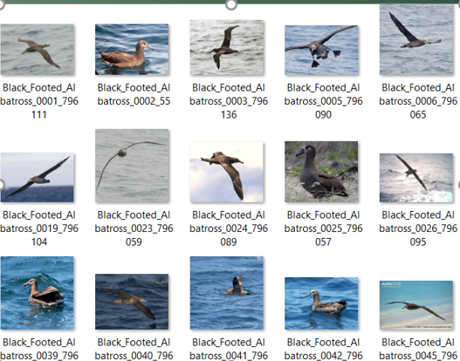
Data Set
The dataset is avaliable at Caltech-UCSD Birds-200-2011 dataset.
Caltech-UCSD Birds 200 (CUB-200) is an image dataset with photos of 200 bird species (mostly North American).
Number of categories: 200
Number of images: 11788

Slide 8
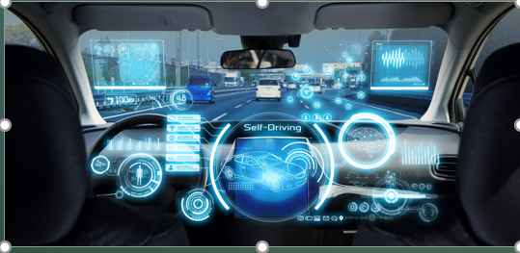

Why CNN?
The convolutional neural network (CNN) is a class of deep learning neural networks.
CNNs represent a huge breakthrough in image recognition.
They’re most commonly used to analyze visual imagery and are frequently working behind the scenes in image classification.
Real Time examples of CNN used Applications:
They can be found at the core of everything from Facebook’s photo tagging to self-driving cars, Image and Video Recognition.

Slide 9
Abstract view of Algorithm
Start with an input image
Apply different filters to it to create a feature map
Apply a ReLU function to increase non-linearity
Apply a pooling layer to each feature map
Flatten the pooled images into one long vector.
Input the vector into a fully connected artificial neural network.
Process the features through the network. The final fully connected layer provides the “voting” of the classes that we’re after.
Train through forward propagation and backpropagation for many, many epochs. Repeat training until a well-defined neural network with trained weights and feature detectors is obtained.

Slide 10
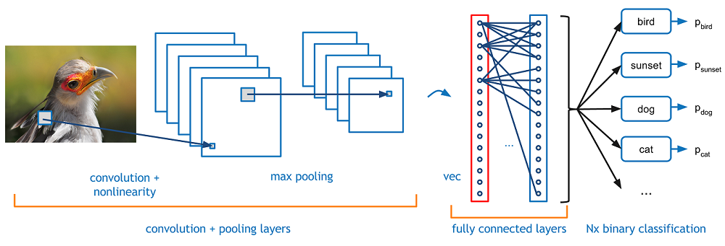
CNN Architecture

Slide 11
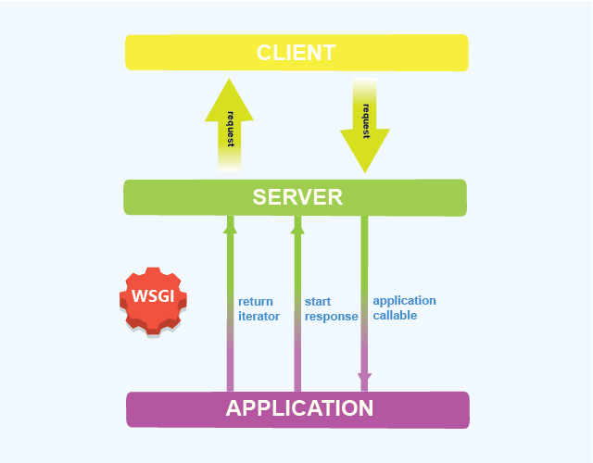
Implementation
Flask
Flask Architecture
Flask is a popular, extensible web microframework for building web applications with Python.
It is a lightweight WSGI web application framework.
WSGI:Web Server Gateway Interface

Slide 12
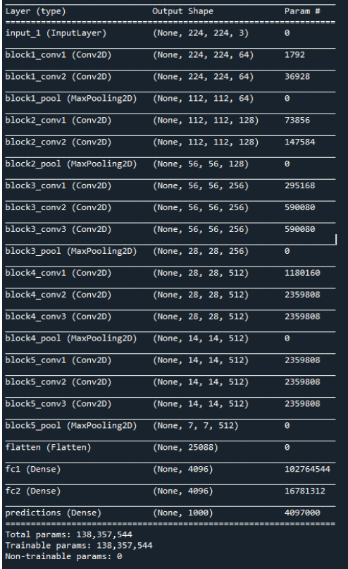
Implementation
Model Summary
Name and type of all layers in the model.
Output shape for each layer.
Number of weight parameters of each layer.
If the model has general topology (discussed below), the inputs each layer receives
The total number of trainable and non-trainable parameters of the model.

Slide 13
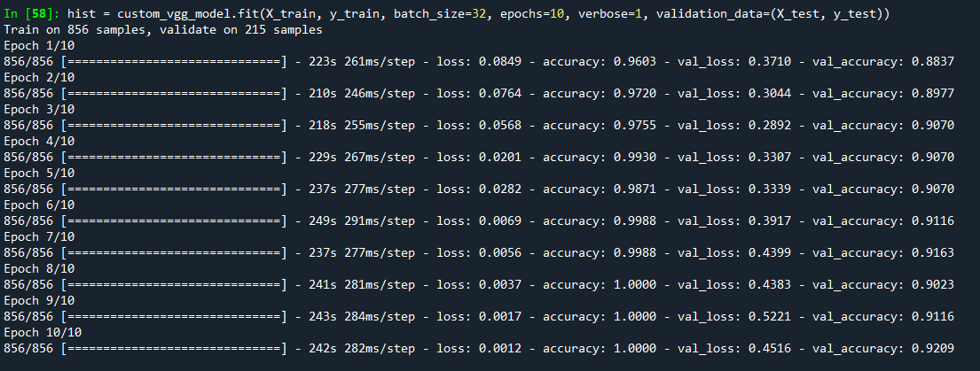
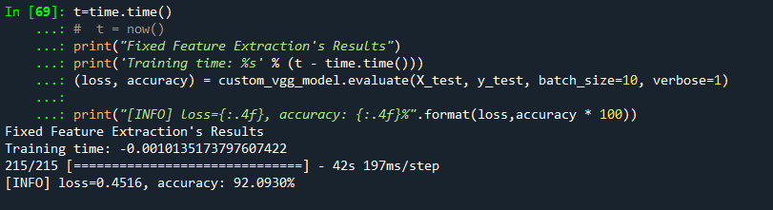
Results
Model Fit

Slide 14

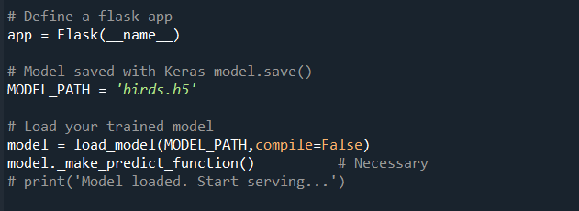
Implementation
Weights of the Model are Saved.
Loading the Saved Model in Web

Slide 15
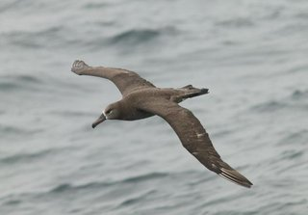
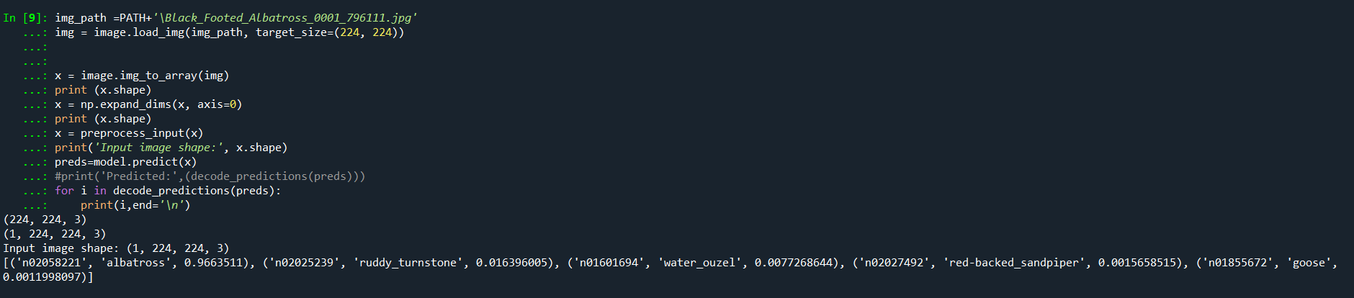
Model Testing

Slide 16
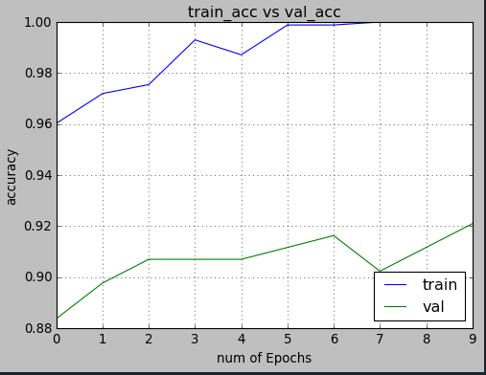
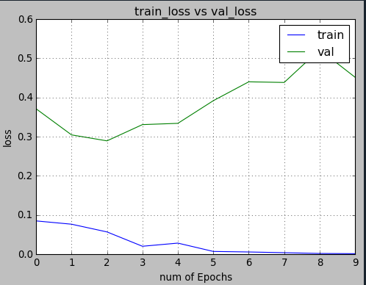
Results
Accuracy
Loss

Slide 17
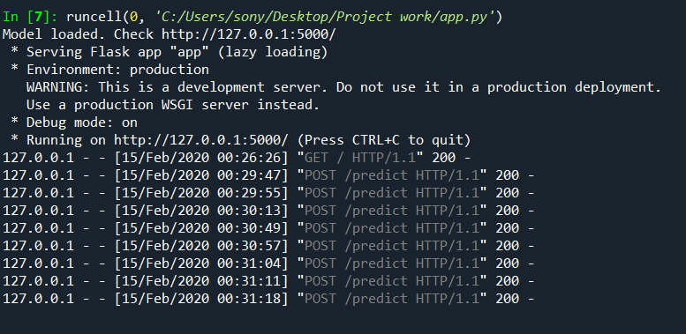
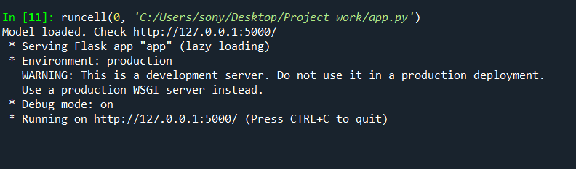
Local Computer Host(Server) Deployed model runs in 127.0.0.1

Slide 18
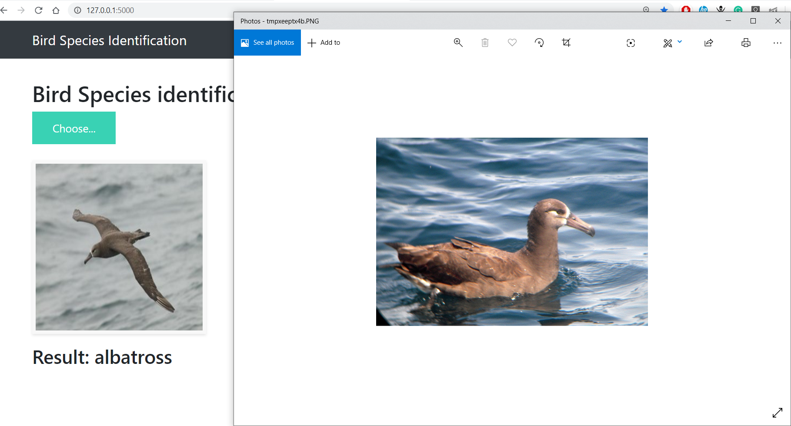
Testing

Slide 19
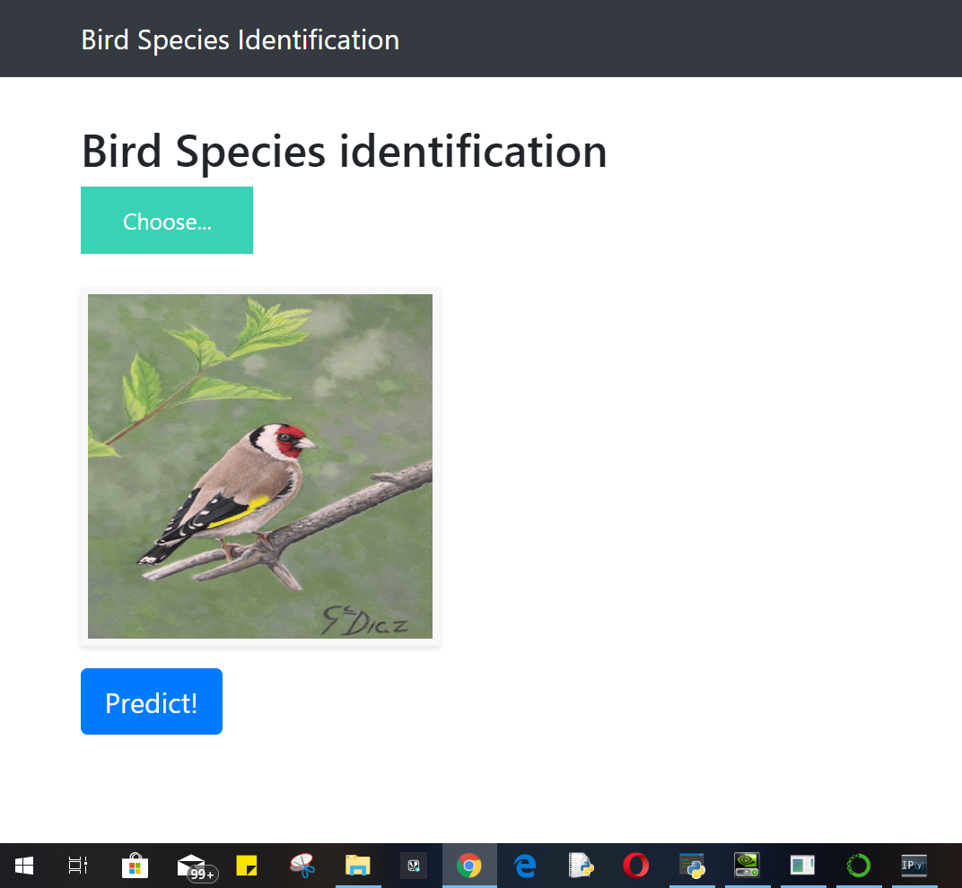
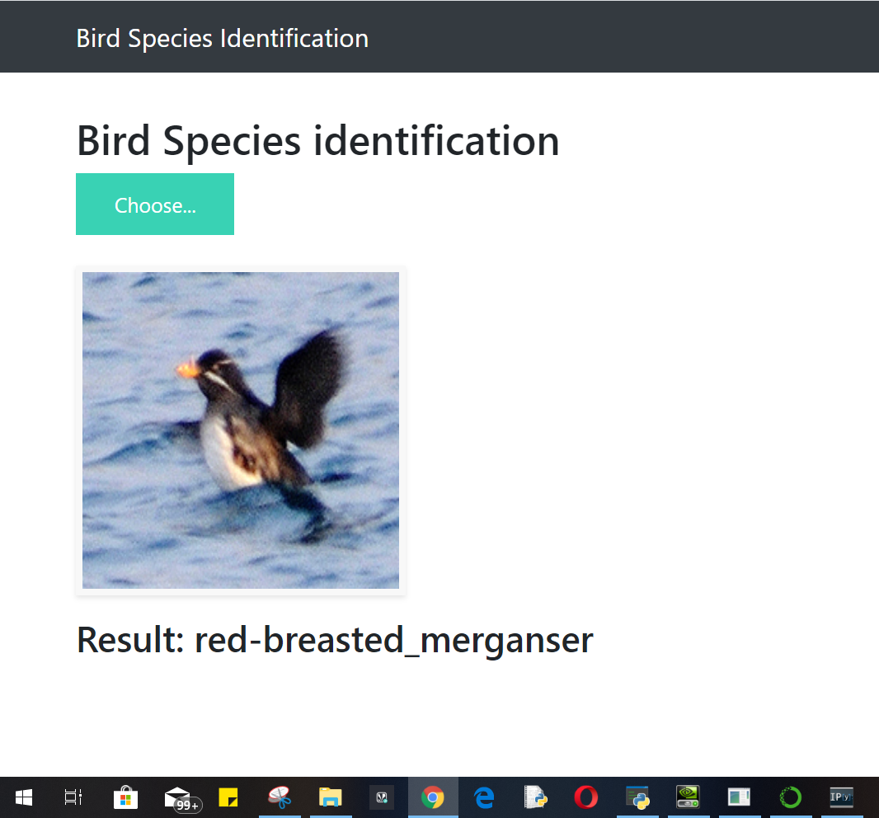
Testing

Slide 20
Conclusion & Future Scope
The main idea behind developing the identification software is to build awareness regarding bird-watching, bird and their identification, especially birds.
System can be implemented using cloud which can store large amount of data for comparison and provide high computing power for processing (in case of Neural Networks).

Slide 21
Bibliography
[1] Bird Species Identification using Deep Learning.
https://flask.palletsprojects.com/en/1.1.x/
https://towardsdatascience.com/

Slide 22
THANK YOU ☺ ☺

